Slide 1
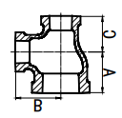
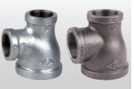
Reducing tee
(reducing 2 sizes)
Fig. 130R

